Slide 1
Final Project Check-in 2
Harshit Modi 200493871 MDEV W2022

Slide 2
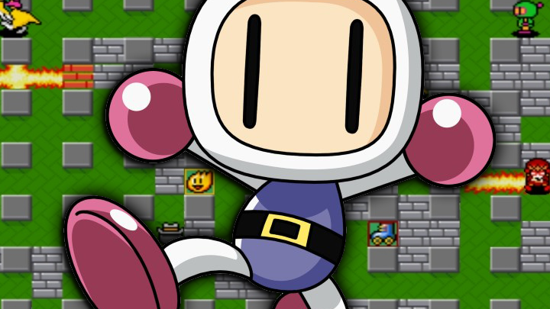
Super Bomberman

Slide 3
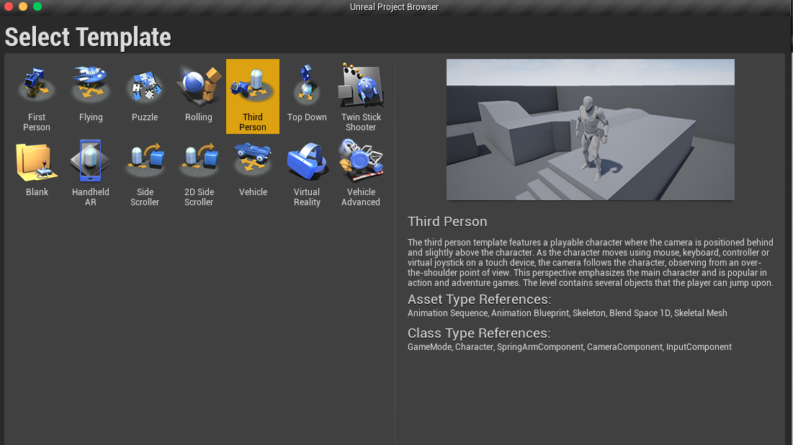
Blueprint Template Selected

Slide 4
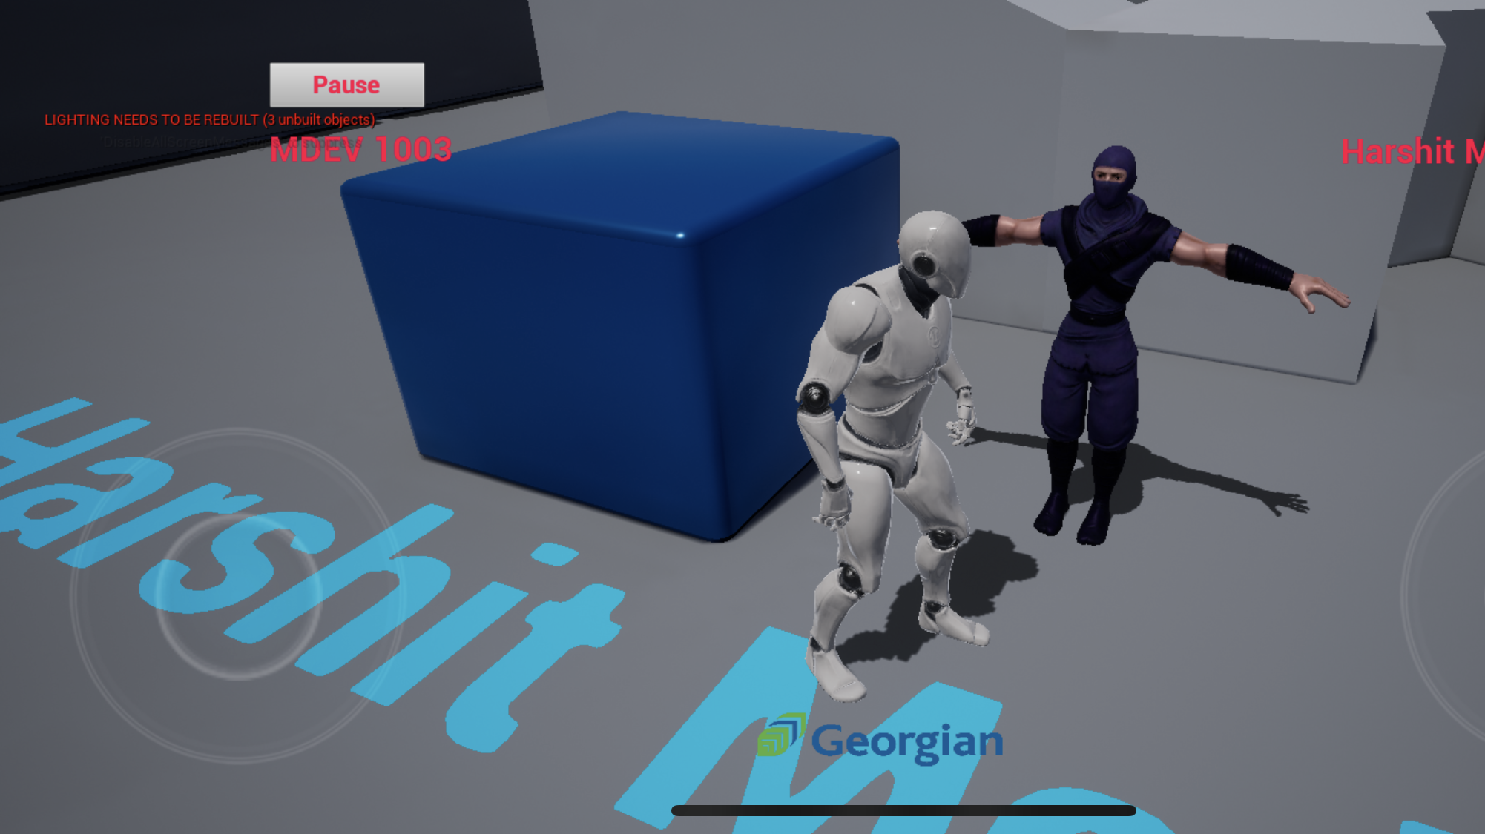
Game Environment
Initially 200 Seconds are given to finish level.
Current game score is displayed in the center top.
Bricks can be blown by bomb and path can be created.
Character can travel in all 4 directions.
Player can drop bomb.
If the player is caught in bomb flame – Game Over.

Slide 5
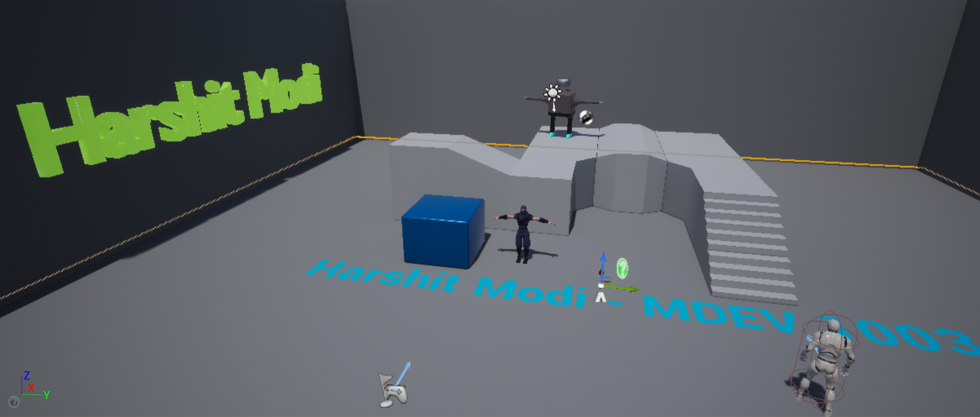
Game Screen
Player can set drop bomb and need to stay 2 blocks away from it.
Game objective is to find end gate and collect coins.
Bricks can be blown using bomb but the steel structure will have no impact.
If the player is caught in bomb flame – Game Over.

Slide 6
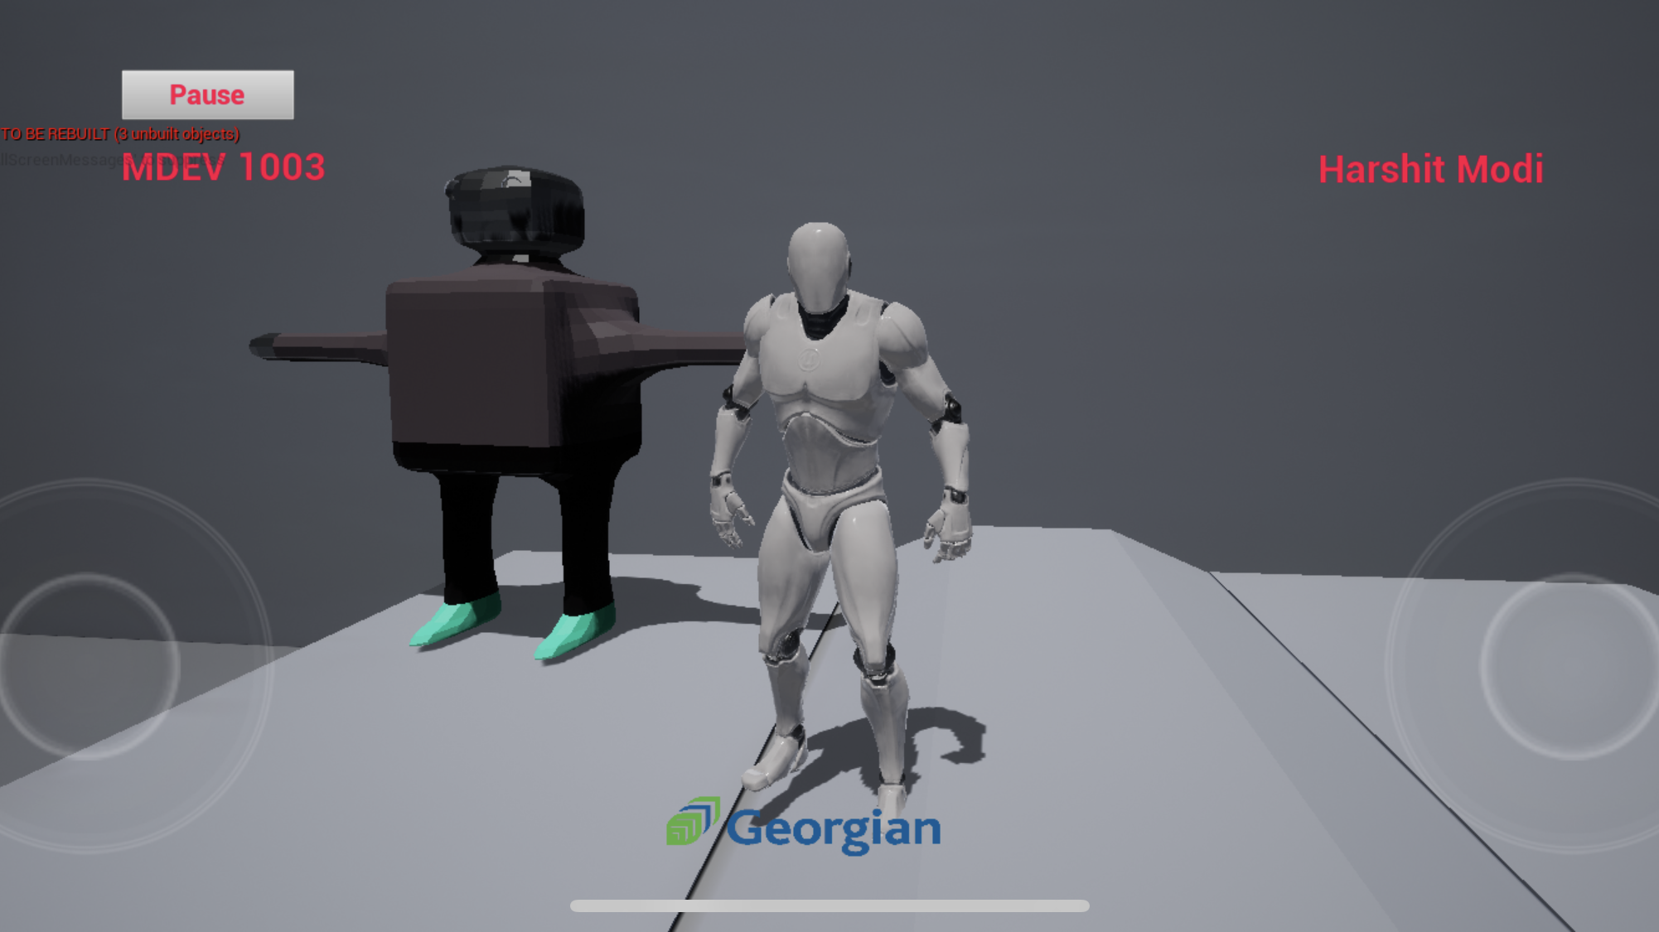
Game Score
Player collects coins and score is increased.
Player has to collect all coins before time is over.

Slide 7
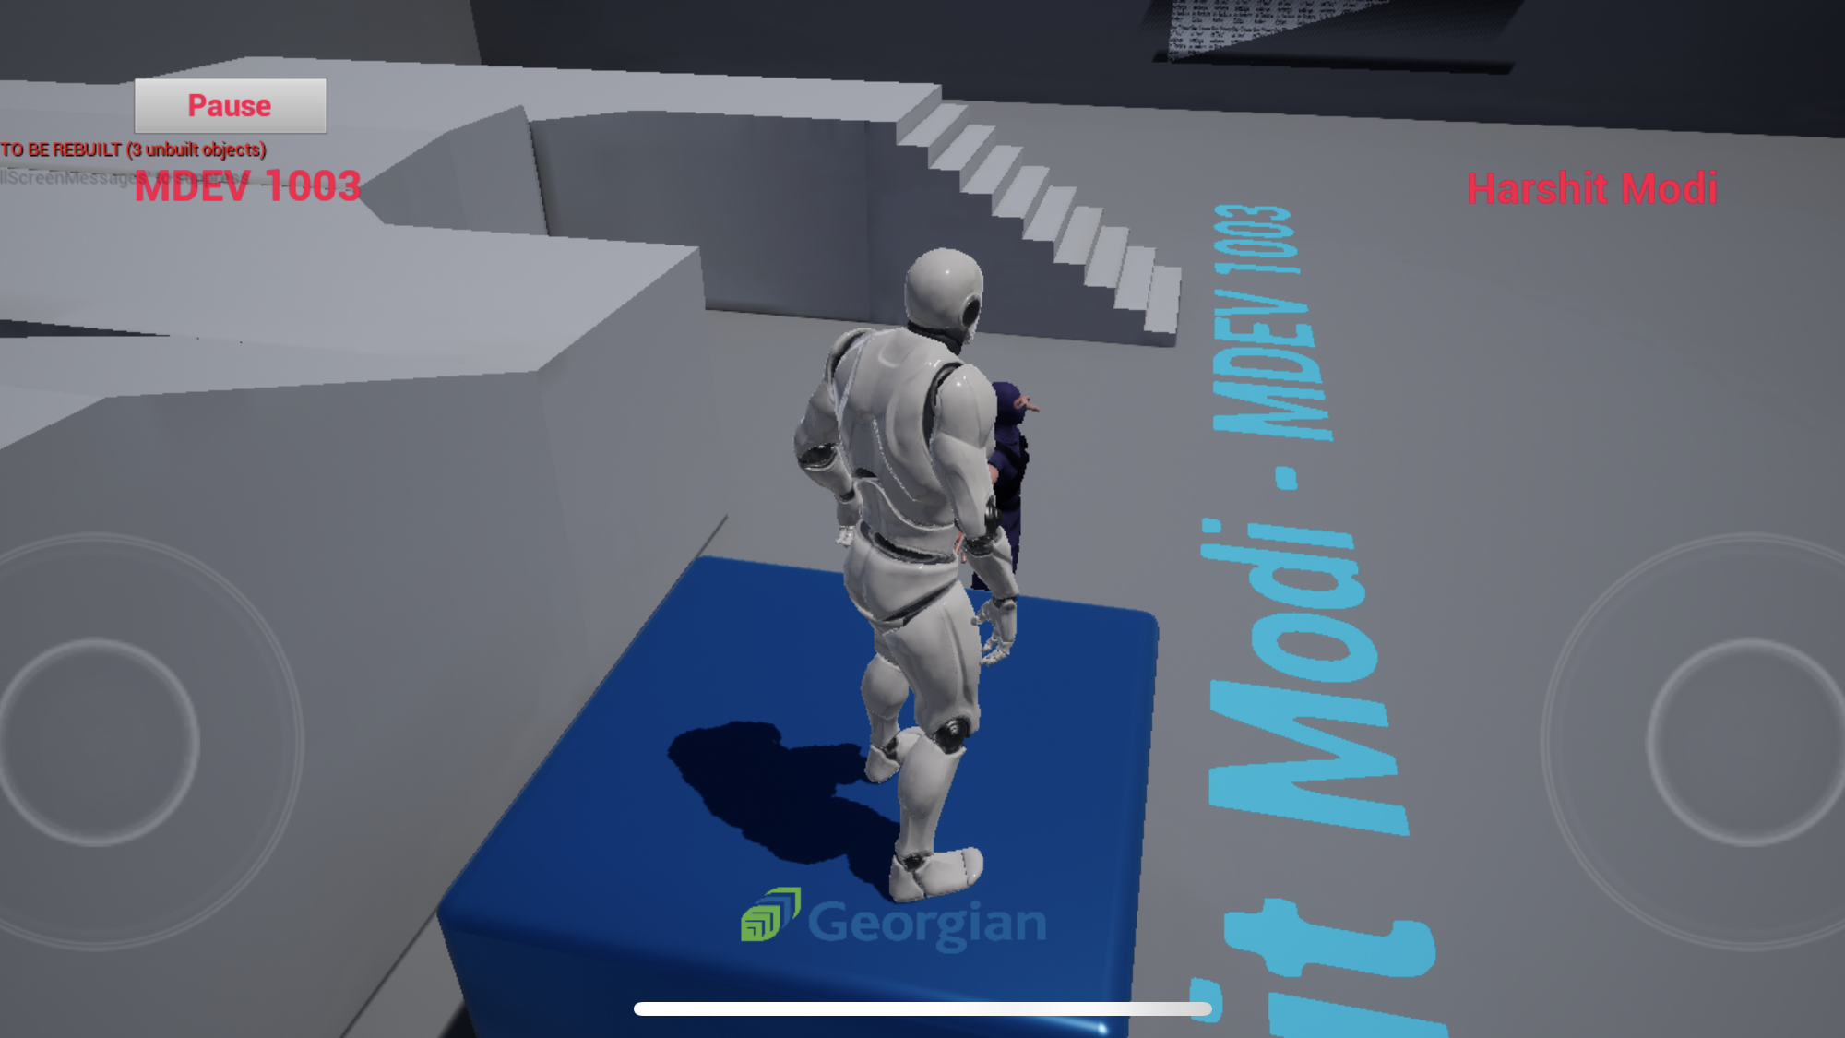
Game Controls
Two thumb control.
Landscape mode.
Joystick control on left thumb.
Change camera viewing angle on right thumb control.
Bomb button on screen tap.

Slide 8
Game Progress

Slide 9
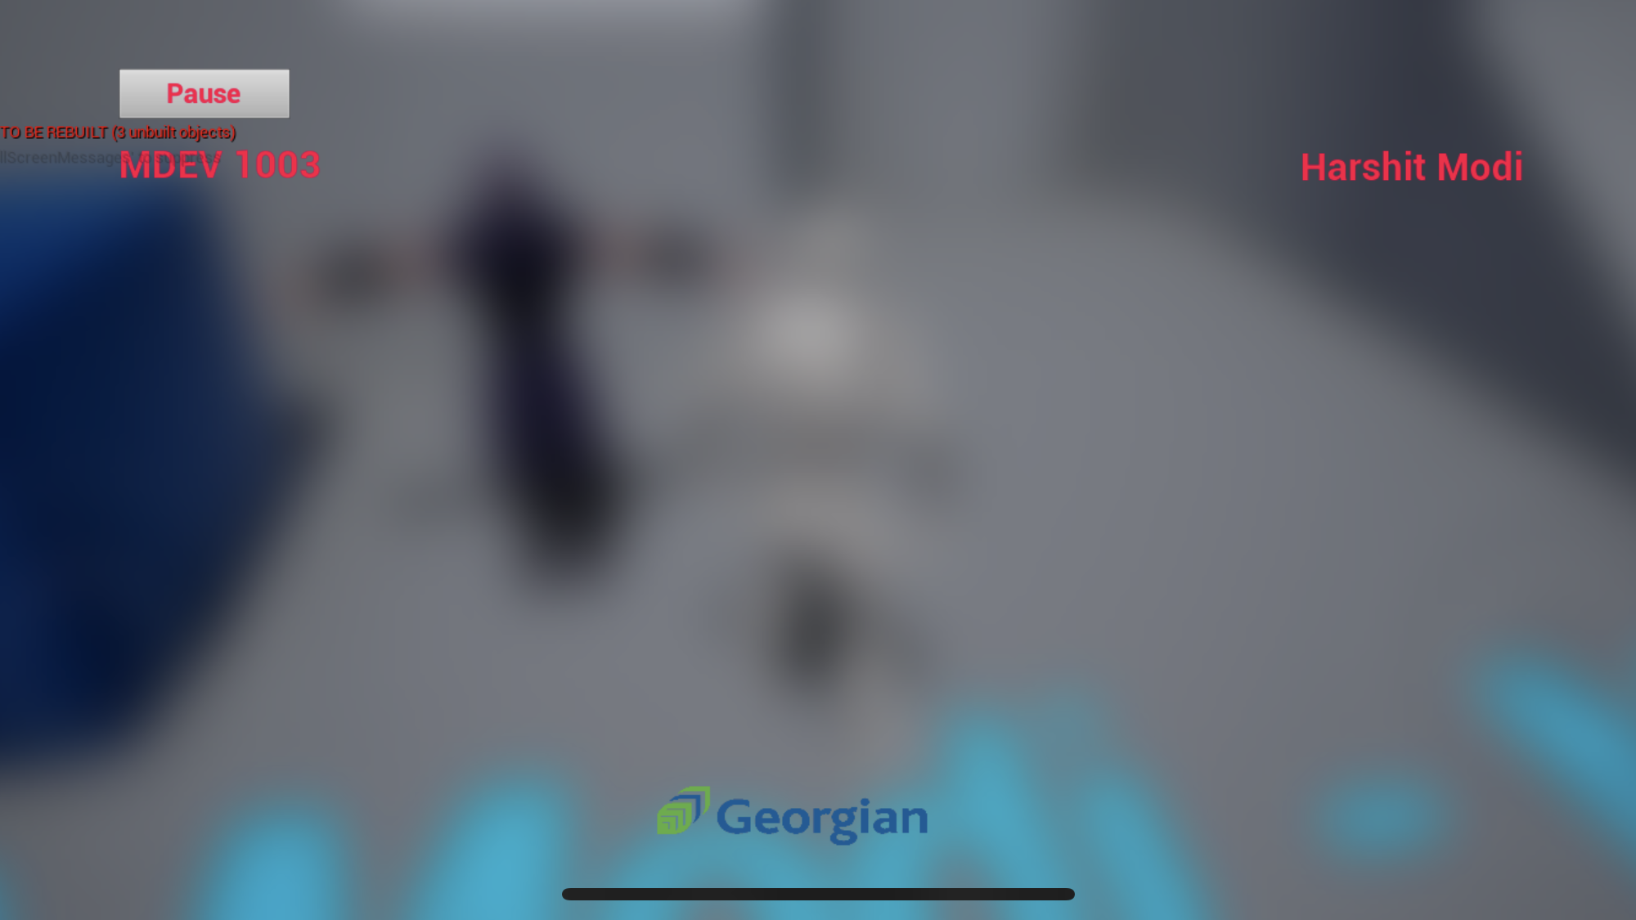
HUD
User can click on pause button to stop the game play.
User can resume game again by tapping on pause button.
The HUD will contain details of game score and lives left.

Slide 10
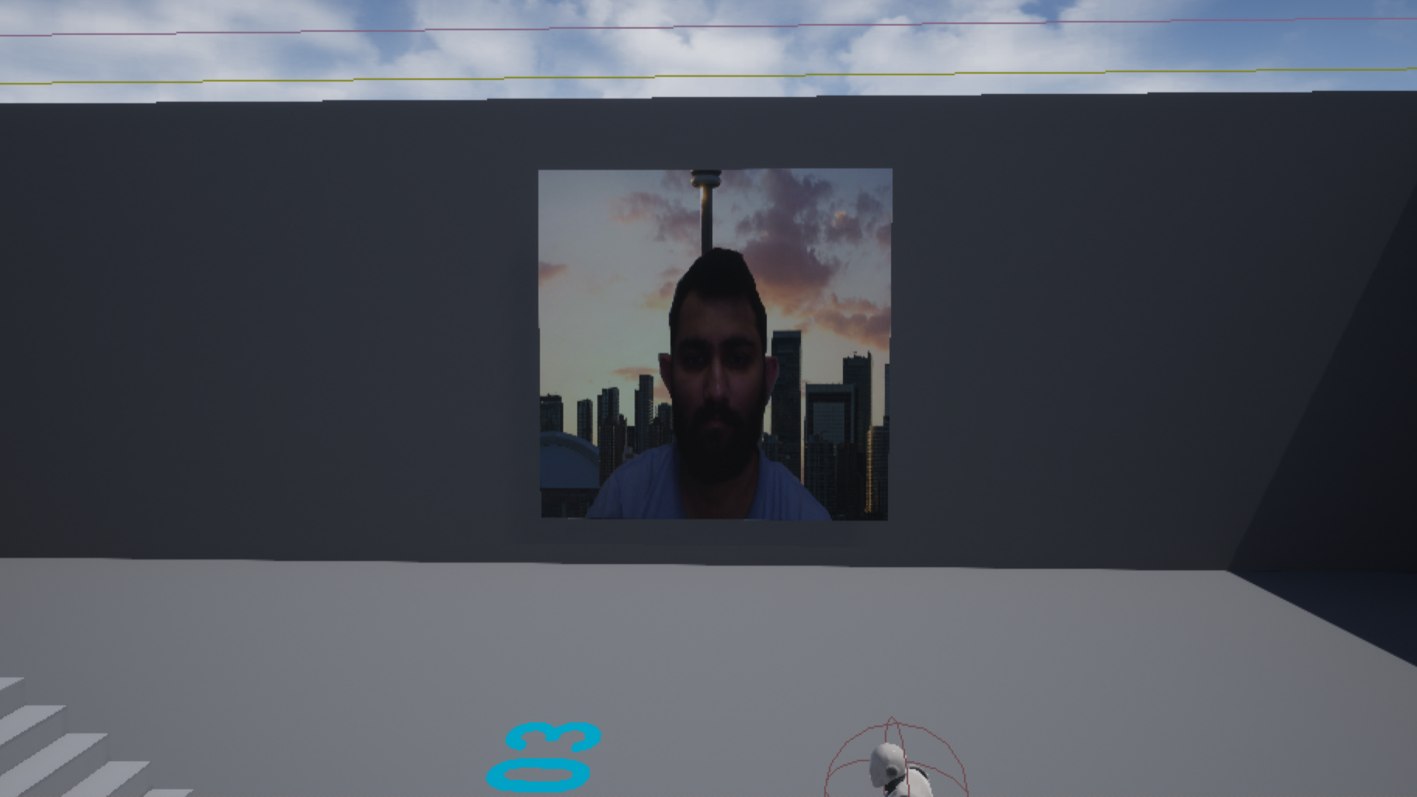

Slide 11
Resources
Created robot model in blender.
Used bensound-moose music as a background music on loop.
Used GIMP for image asset cleanup.
Used Ninja character from mixamo.

Slide 12
References
StartPage: https://www.google.com/url?sa=i&url=https%3A%2F%2Fwww.retrogames.cz%2Fplay_085-NES.php&psig=AOvVaw3T3xf0j_rqXkT1gCRJSUvg&ust=1642712266178000&source=images&cd=vfe&ved=0CAsQjRxqFwoTCOCsnpvavvUCFQAAAAAdAAAAABAI
GameLogo: https://styles.redditmedia.com/t5_2tk3f/styles/communityIcon_c9bkwed5d2d71.png
GamePage: https://www.google.com/url?sa=i&url=https%3A%2F%2Finsight-egypt.com%2Fjvaa.php%3Fiid%3D467176195-bomberman%2Bnes%2Bonline%26cid%3D123&psig=AOvVaw3T3xf0j_rqXkT1gCRJSUvg&ust=1642712266178000&source=images&cd=vfe&ved=0CAsQjRxqFwoTCOCsnpvavvUCFQAAAAAdAAAAABAn
GameControl: https://mobilefreetoplay.com/wp-content/uploads/2014/08/touch-control-design-less-control-is-more-300x167.jpg

Slide 13
Thank you
Name: Harshit Maheshkumar Modi
Student ID: 200493871
Course: MDEV1003 W2022

